Slide 1




Cholera Outbreak Investigation in Migori County, Kenya, February–April 2025: A Comprehensive Analysis of Transmission Dynamics in Border Communities
Affiliation: Kenya FELTP
Presenter: Annette Chesir
Co-authors: Habiba Mohamed, Fredrick Mutisya, Maurice Owiny
Thematic area: Epidemic & Pandemic Preparedness
t Institutional Affiliations
Kenya Health Security Convention | 5th – 8th May 2026 | Mombasa - Kenya

Slide 2
Background
In February 2025, Migori County notified the national response team of increased acute watery diarrhoea cases(AWD)
  One death
County is strategically positioned along the Kenya-Tanzania border¹
  Create unique demographic
  Geographical characteristics
The county has been identified as a cholera hotspot¹
  Population mobility
  Shared unprotected water sources across the border
AWD cases tested positive on Cholera rapid test kit(RDT)
  A team was deployed to conduct an investigation
  support the county in responding to the outbreak

Slide 3
Objectives
To describe the epidemiological characteristics of the cholera outbreak
To determine antimicrobial susceptibility patterns of V. cholerae isolates
To assess environmental risk factors and water source contamination

Slide 4
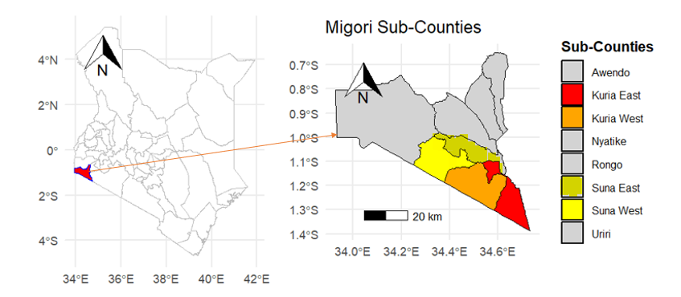
Methodology
  Investigation in four sub-counties: Kuria East, Kuria West, Suna East, and Suna West

Slide 5
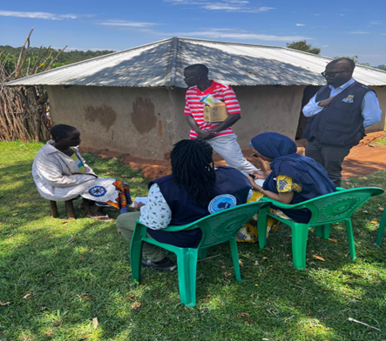
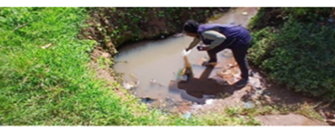
Approach
Identified cases using a three-tiered definition adopted from the Kenya Cholera policy guideline
  suspected, probable, and confirmed
Conducted active case finding
  Used Case Investigation Form
  Reviewed medical records
  Traced contacts: snowballing
Assessed water and sanitation
  Sampled water from suspected contaminated sources
  Analyzed water samples using the MPN method for coliform enumeration
Confirmed cases using stool culture
Conducted antimicrobial susceptibility testing

Slide 6
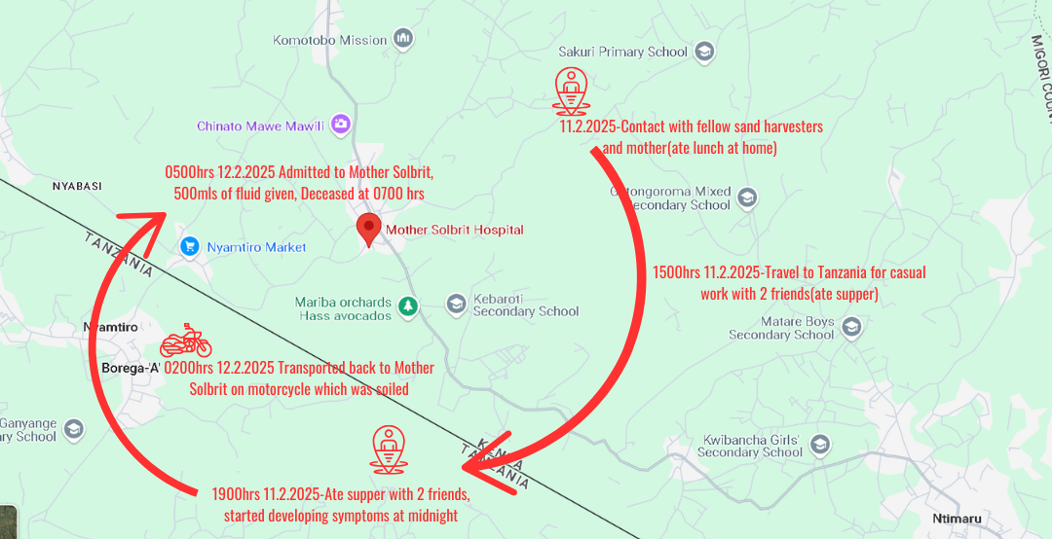
Index case movement history

Slide 7
Demographics of Cholera cases in Migori County, February–April, 2025
Variable | Count(n=53) | (%) | 95% CI
Age group
0–9 | 8 | 15.1 | 6.7–27.6
10–19 | 8 | 15.1 | 6.7–27.7
20–29 | 13 | 24.5 | 13.8–38.3
30–39 | 10 | 18.9 | 9.4–32.0
40–49 | 6 | 11.3 | 4.3–23.0
≥50 | 8 | 15.1 | 6.7–27.6
Gender
Male | 32 | 60.4 | 46.0–73.6
Female | 21 | 39.6 | 26.4–54.0
Occupation
Farmers | 17 | 32.1 | 20.3–46.0
Students/Pupils | 7 | 13.2 | 5.4–25.3
Sand havesters | 7 | 13.2 | 5.4–25.4
Gold miners | 7 | 13.2 | 5.4–25.5
Elderly | 6 | 11.3 | 4.3–23.0
Food vendors | 4 | 7.5 | 2.1–18.2
Children | 3 | 5.7 | 1.2–15.7
Others | 2 | 3.8 | 0.5–13.0
Sub-County
Kuria East | 23 | 43.4 | 30.0–57.7
Kuria West | 17 | 32.1 | 20.3–46.0
Suna East | 9 | 17 | 8.1–29.8
Suna West | 4 | 7.5 | 2.1–18.2

Slide 8
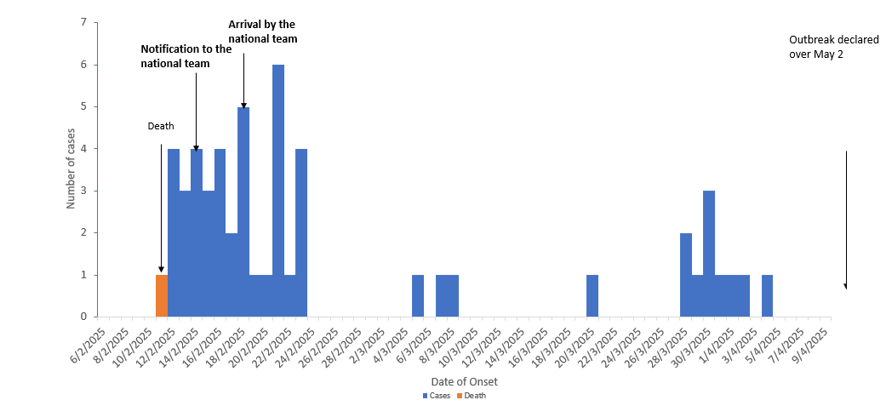
Results

Slide 9
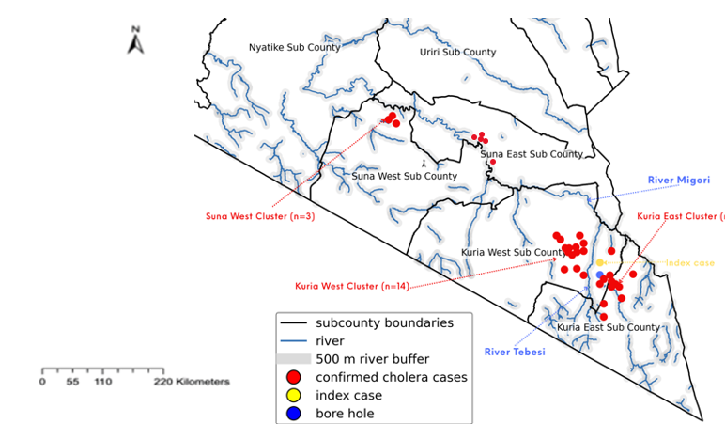
Cluster of cases along river Tebesi and River Migori
Case concentration along rivers Tibesi and Migori
Index case had 2 of his contacts developing symptoms 2 days later

Slide 10
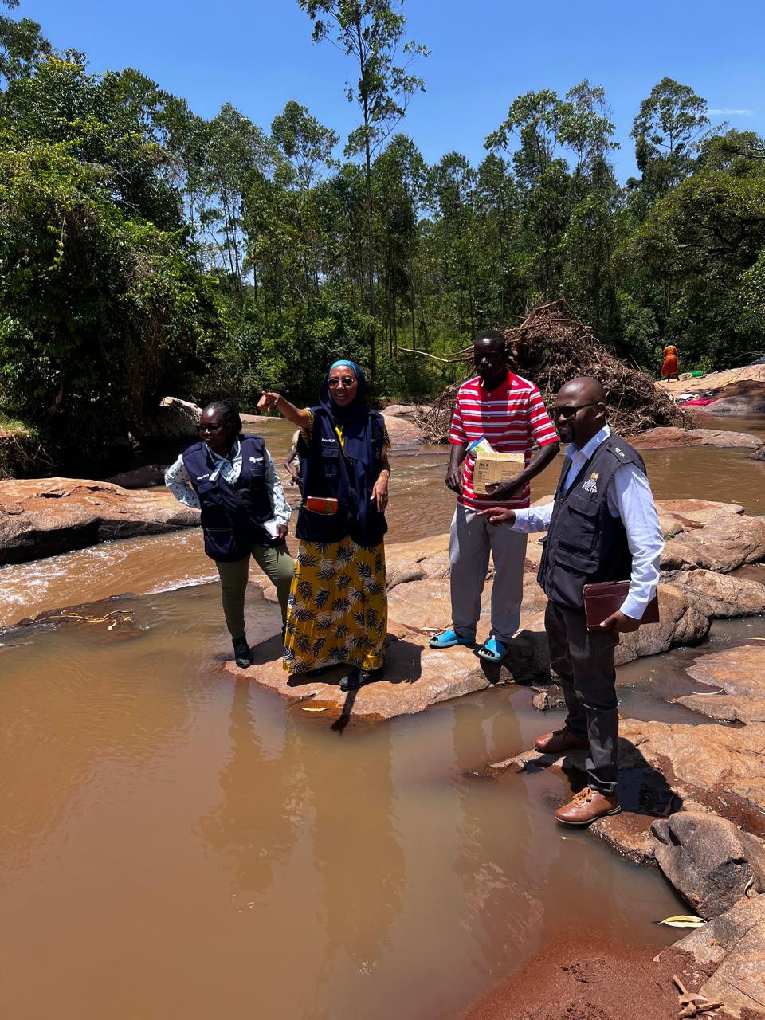
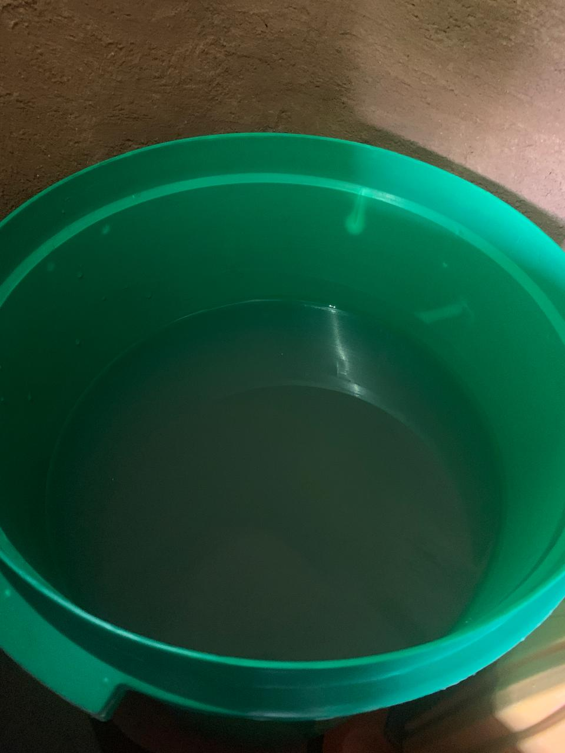
Assessment of Water, Sanitation and Hygiene
80% of respondents reported drinking untreated water
  Water stored in uncovered containers
Common water sources;
  Borehole/well: 60%
  River: 30%
  Rain water: 10%
  Unprotected spring: 10%
100% of respondents used latrines
  All had handwashing stations (As a response to the outbreak?)
Visit to River Tebesi
Uncovered water storage in the household

Slide 11
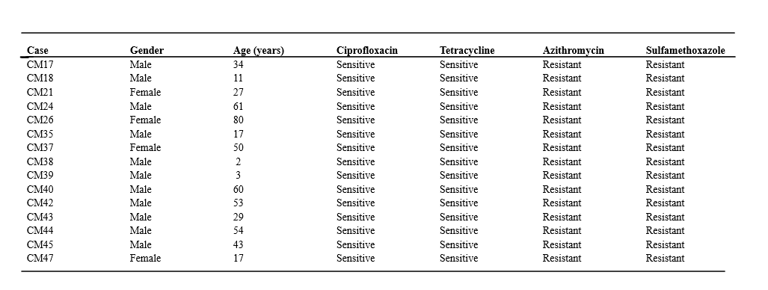
Results

Slide 12
Migori Cholera Outbreak February—April 2025|Assessment of 7-1-7
DETECT
Target<7 days
NOTIFY
Target 1≤ day
RESPOND
Target <7 days
1 day
1 day
1 day
Timeliness
Emergence 11 Feb 2025
Detection 12 Feb 2025
Notification 13 Feb 2025
Response start 14 Feb 2025
Early response end 26 Feb 2025
Cross-border movement
Early mild symptoms
Resource mobilization
Achieved
bottlenecks
RDT availability & testing
HCW High suspicion
Prompt facility reporting
NPHI & AFENET|Partners
FELTP|DDSR|Migori County
Enablers
Increase Nationwide IDSR trainings for providers at private/public facilities
Implement mandatory Cholera outbreak simulation

Slide 13
Discussion
Epidemiological pattern consistent with similar border outbreaks
  Male predominance (60.4%) aligns with inland Kenya reports (Homa Bay 58-61%)
  Index case cross-border travel raises possibility of Tanzanian exposure (11 hrs incubation)
  Protocol prevented cross-border contact tracing - may underestimate imported cases
Antimicrobial Resistance
  Universal resistance to azithromycin and trimethoprim/sulfamethoxazole
  100% sensitivity to ciprofloxacin and tetracycline - treatment options preserved
  Similar to Kisumu (99% cotrimoxazole resistance) but unlike Asian outbreaks (lower AMR)
Environmental Findings
  V. cholerae not detected in water sources; but fecal coliform contamination widespread
  River Migori: 33 CFU/100ml; E. coli positive - classified unsatisfactory
  Low CFR (1.9%) vs Uganda Kasese (2.1%), South Sudan (1.7-3%) - reflects rapid response

Slide 14
Conclusion
We identified V. Cholerae Ogawa as the causative agent
Border communities create unique vulnerability profiles due to unregulated movements
All isolates showed universal resistance to azithromycin and sulfamethoxazole/trimethoprim while remaining sensitive to ciprofloxacin and tetracycline
  These findings contribute essential data to global AMR surveillance and inform treatment guidelines for resource-limited settings
We documented widespread fecal contamination in water sources across affected communities
Our findings provide evidence supporting WHO's emphasis on WASH interventions as fundamental to global cholera elimination strategies

Slide 15
Policy Impact and Implications: Migori County and Stakeholders
Support the capacity building of health workers on cholera detection and management
Strengthen Risk Communication
Strengthen IPC
County to increase water treatment points in water-scarce sub-counties
Strengthen cross-border surveillance collaboration
Make Cholera simulation exercises mandatory every 3 months at every level of service delivery in both public and private facilities

Slide 16

Thank you!
Scan to visit our website
#KeHSCon2026
@NPHIKenya
www.nphi.go.ke

